Slide 1
Diabetes
Mohammed Ashour
Mohammed Alhelou
ayoub alladaa

Slide 2
INTRODUCTION
Diabetes is a chronic disease characterized by high levels of sugar (glucose) in the blood. It occurs when the body is unable to produce enough insulin or is unable to effectively use the insulin it does produce. Insulin is a hormone that helps regulate the amount of glucose in the blood. If left uncontrolled, diabetes can lead to serious health complications such as heart disease, blindness, and kidney disease.
T
1

Slide 3
INTRODUCTION
In this demo, we will be using machine learning to build a model that can predict whether or not an individual has diabetes based on certain diagnostic measures. These measures may include the individual's age, blood pressure, body mass index (BMI), and levels of insulin and glucose in the blood. By training a model on a dataset of patients with and without diabetes, we can then use this model to predict whether a new patient is likely to have diabetes.
T
2

Slide 4
Data Dictionary
Pregnancies: To express the Number of pregnancies Glucose: To express the Glucose level in blood Blood Pressure: To express the Blood pressure measurement Skin Thickness: To express the thickness of the skin Insulin: To express the Insulin level in blood BMI: To express the Body mass index Diabetes Pedigree Function: To express the Diabetes percentage Age: To express the age Outcome: To express the final result 1 is Yes and 0 is No
T
3

Slide 5
Project construction steps
03
Visualization
01
Predictive modeling
04
02
Preprocessing
Build GUI desktop applications
T
4

Slide 6
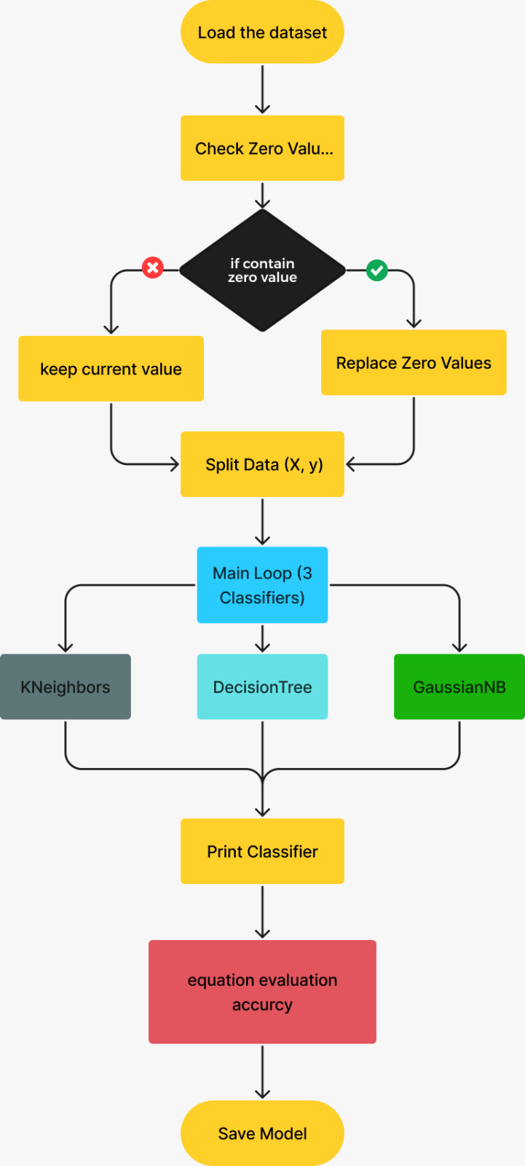

Slide 7
Preprocessing
Imputation :option is to replace the noisy values with the mean of the remaining values in that column. This can be a simple and effective approach, especially for numerical data
After completing the imputation, I did the visualization process to understand the relationships between the columns and to understand the data more
T
5

Slide 8
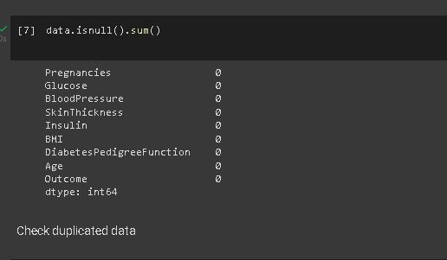
Preprocessing App
Search for empty values ​​in the data
T
6

Slide 9
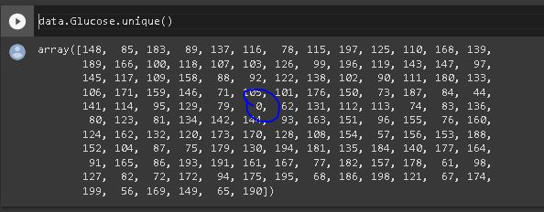
Check if Glucose contains a zero value
There is a zero value, and this is an error that must be exceeded
T
7

Slide 10
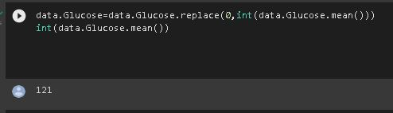
The glucose value cannot be zero, so it replaces the zero values ​​with the glucose column average
T
8

Slide 11
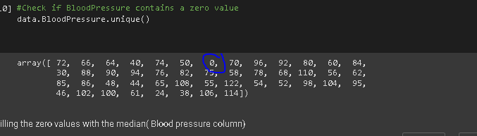

Check if Blood Pressure contains a zero value
Filling the zero values ​​with the median (Blood pressure column)
T
9

Slide 12
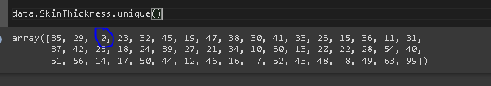
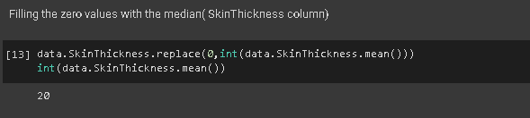
Check if Skin Thickness contains a zero value
T
10

Slide 13
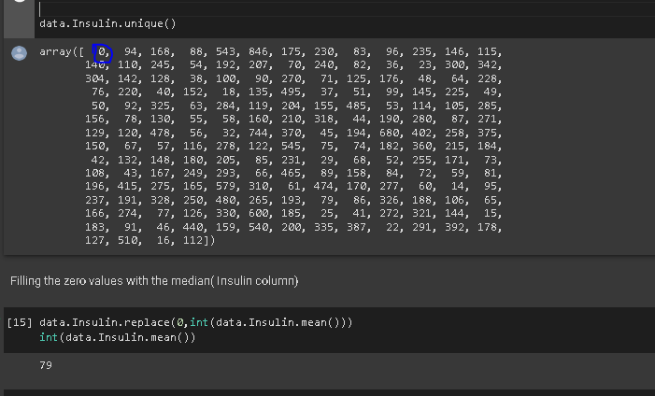
Check if Insulin contains a zero value
Filling the zero values with the median( Insulin column)
T
11

Slide 14
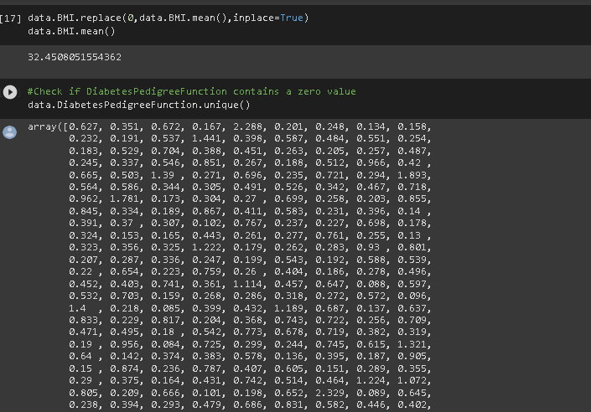
Filling the zero values with the mean( BMI column)
T
12

Slide 15
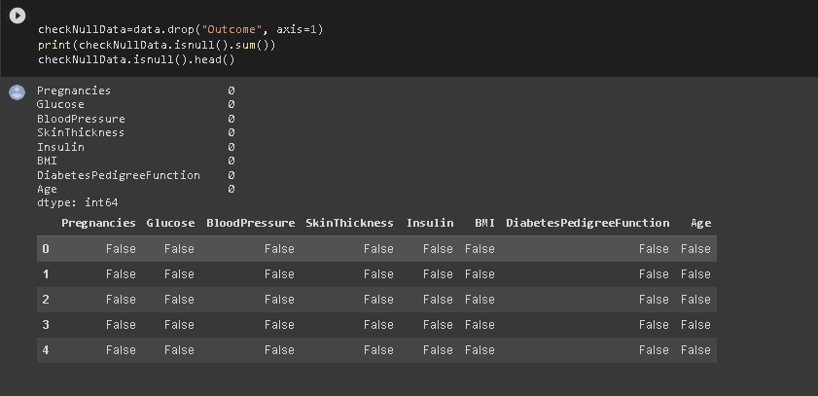
Check if data contains a zero value
T
13

Slide 16
02
Visualization
T
14

Slide 17

visualization libraries
T
15

Slide 18
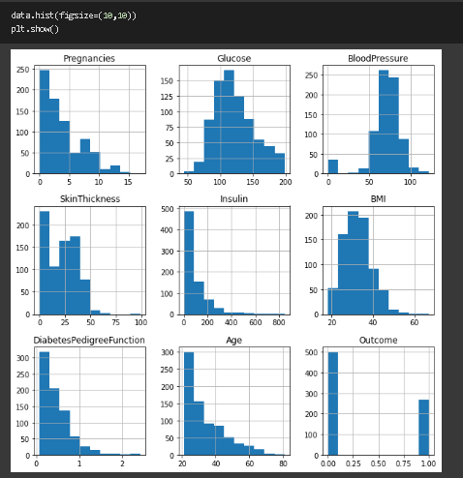
data.hist(figsize=(10,10)) plt.show()
T
17

Slide 19
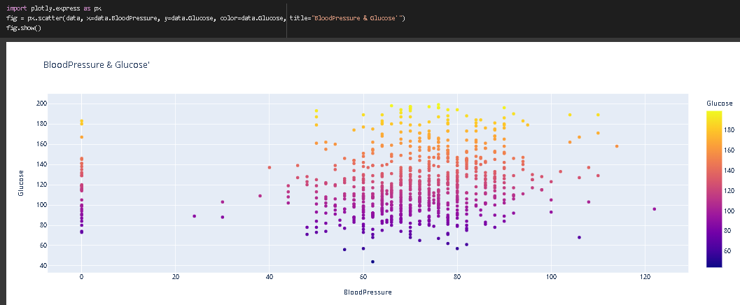
import plotly.express as px fig = px.scatter(data, x=data.BloodPressure, y=data.Glucose, color=data.Glucose, title="BloodPressure & Glucose'") fig.show()
T
18

Slide 20
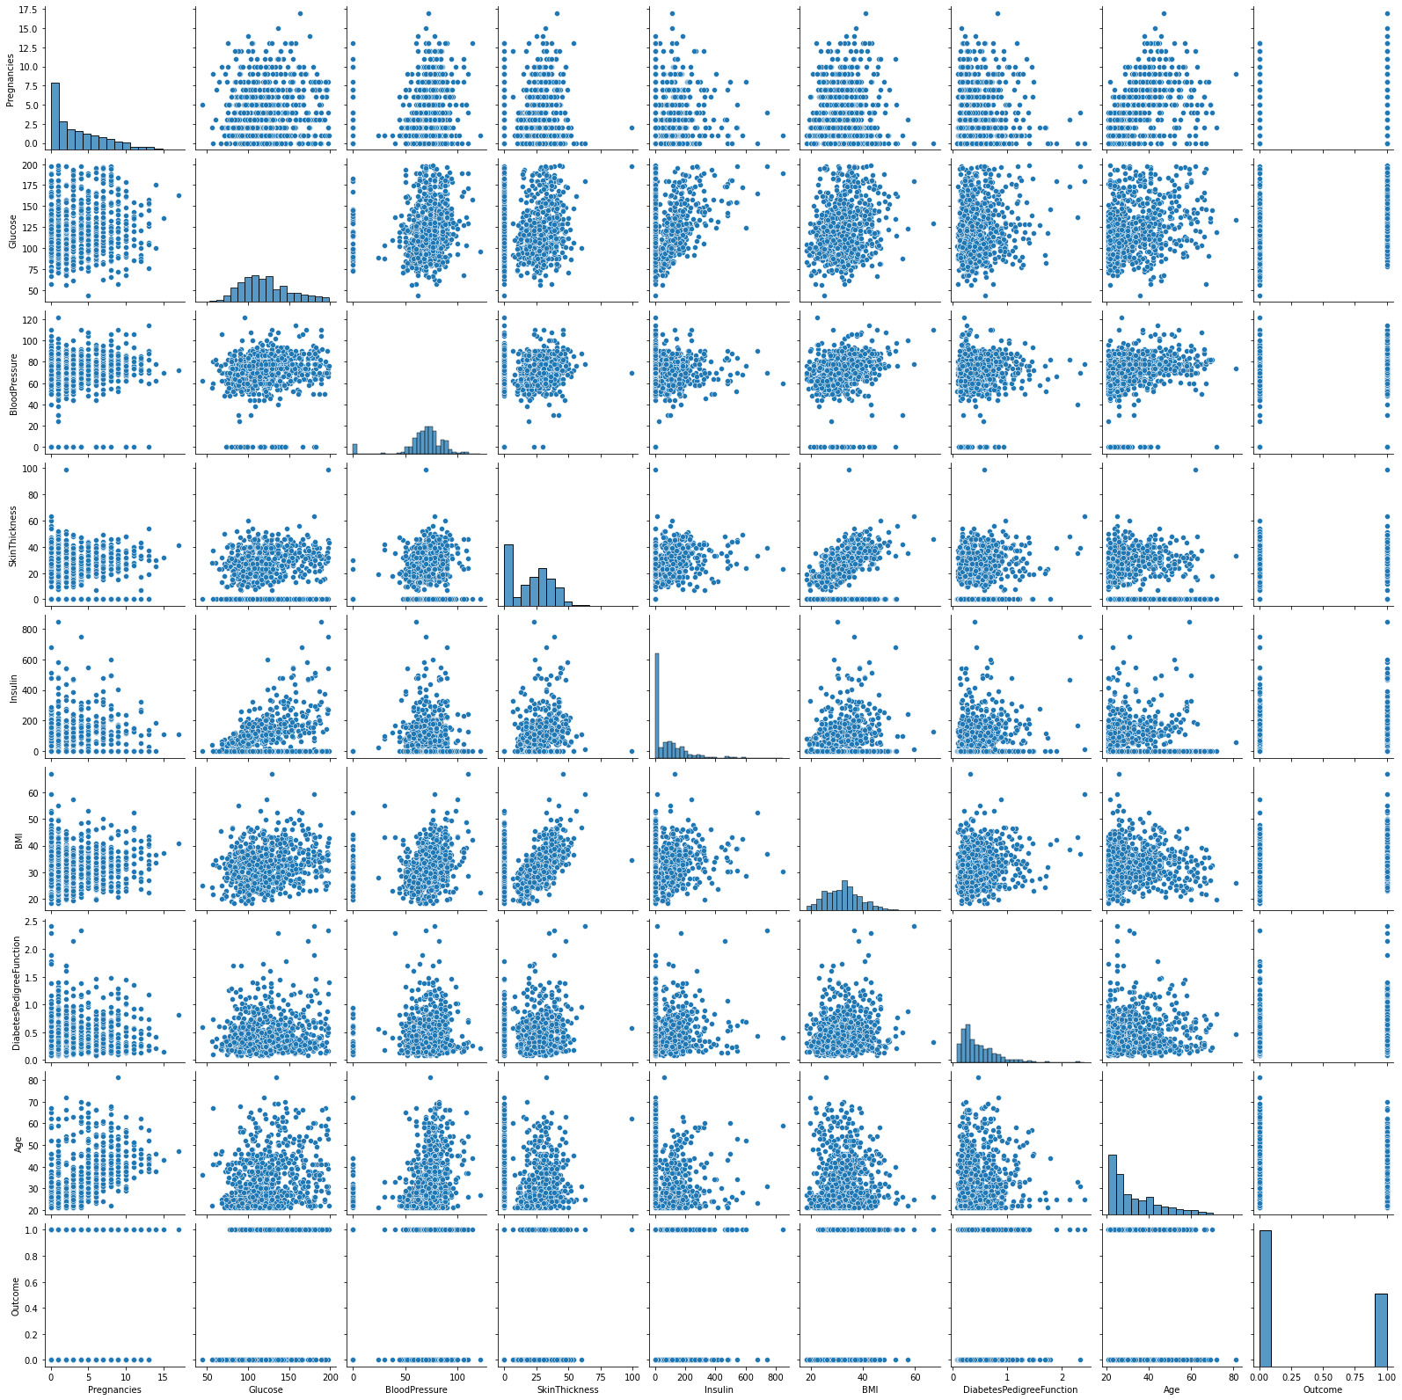
sns.pairplot(data)
T
19

Slide 21
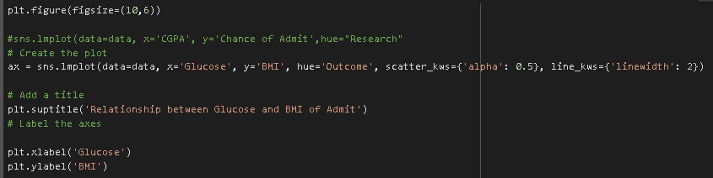
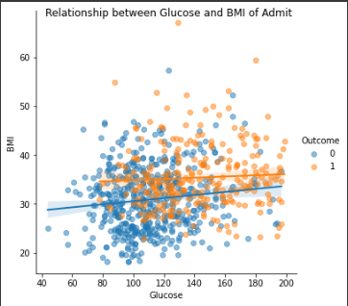
T
20

Slide 22
predictive modelling
KNeighbors
CLUSTERING
Classification
DecisionTree
GaussianNB
T
21

Slide 23
Algorithm Development
75%
For the prediction task, we experimented with various machine learning algorithms, including K-Nearest Neighbors (KNN), Decision Tree, and Gaussian Naive Bayes (GaussianNB). After evaluating their performance, we found that the GaussianNB algorithm provided the highest accuracy with a success rate of 75%.
T
5

Slide 24
Nursing in percentages
52%
40%
95%
However, we noticed a limitation in the dataset, as it contained only 700 rows, which could affect the prediction accuracy. To address this, we initiated a new phase of development to increase the volume of data. We conducted multiple experiments to enhance the model's accuracy.
Random Data Generation
Genetic Algorithm
Data Cloning
T
5

Slide 25
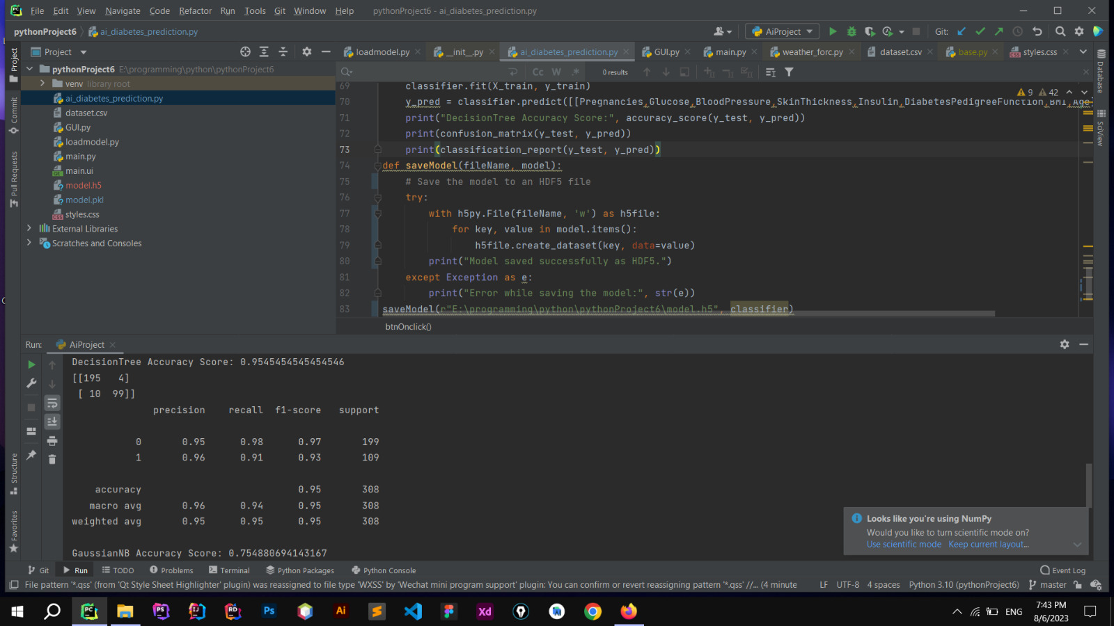

Slide 26
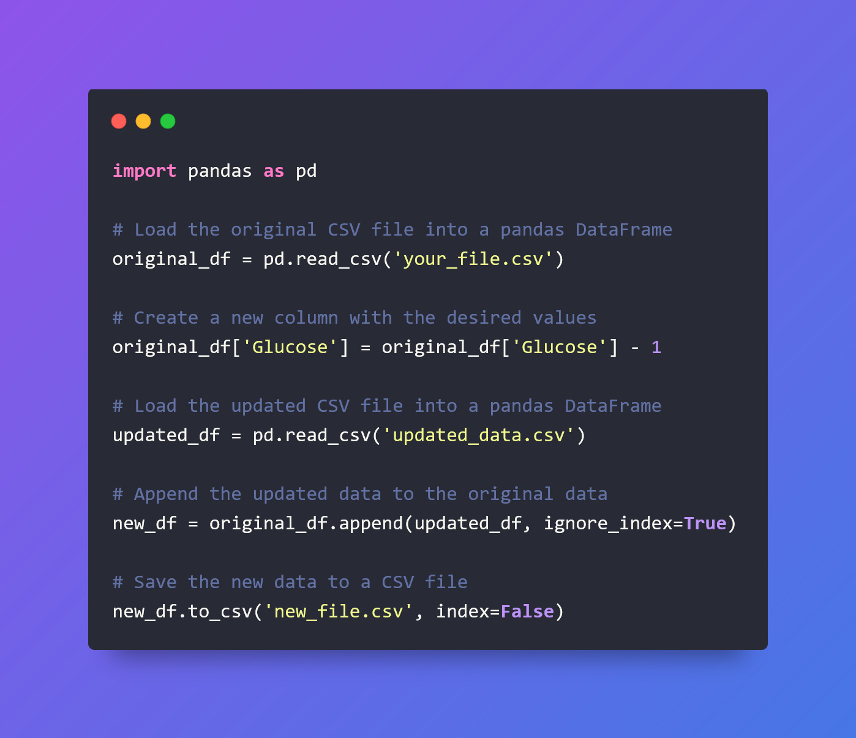
Clone Data

Slide 27
Gui model
1
save model
2
Load model
3
Build Desktop App
T
1

Slide 28
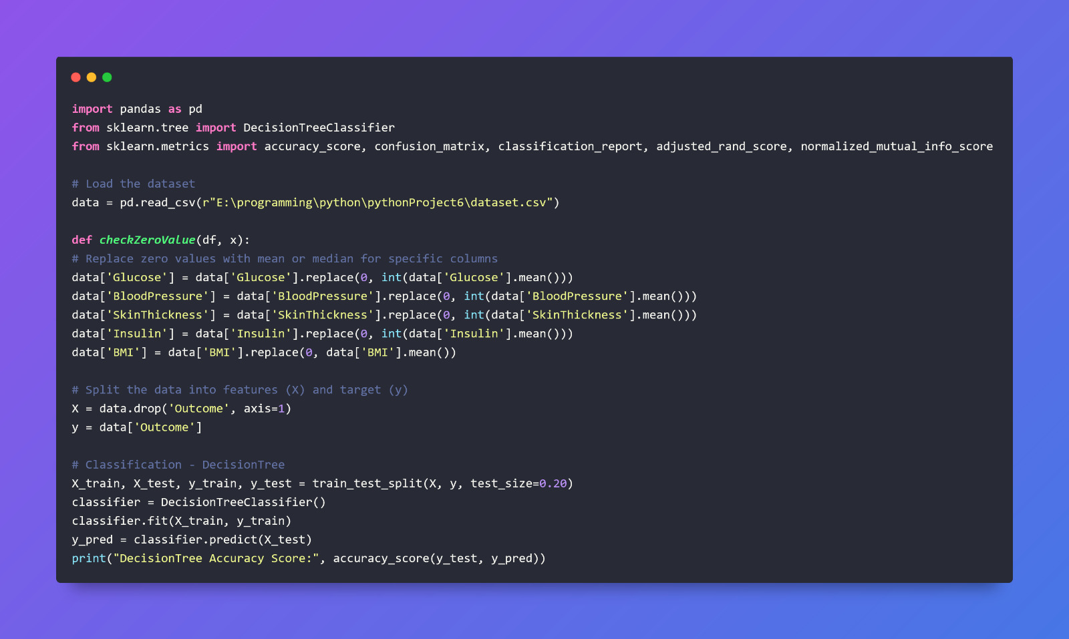
save model

Slide 29
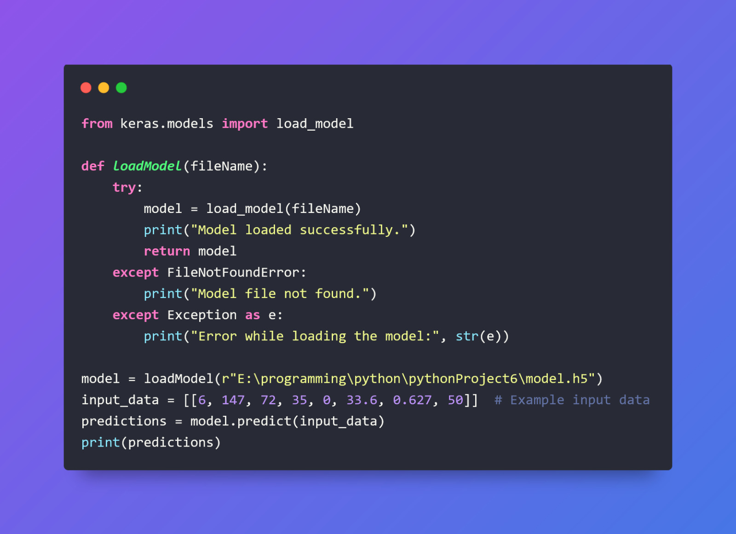
load model

Slide 30
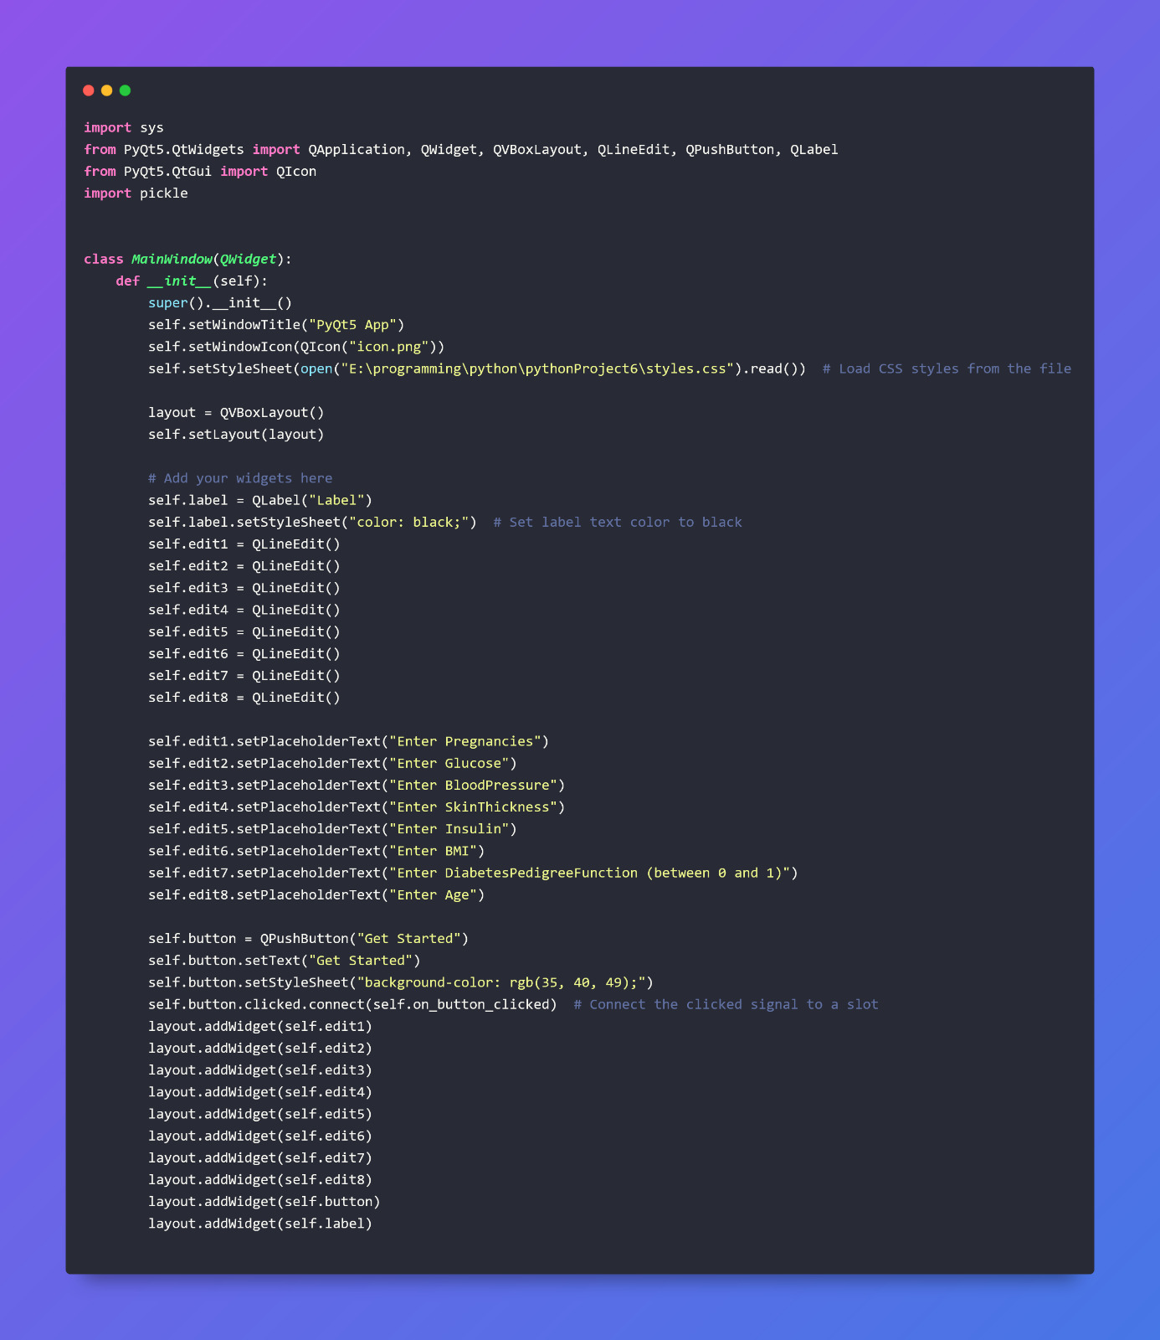
Build Desktop App

Slide 31
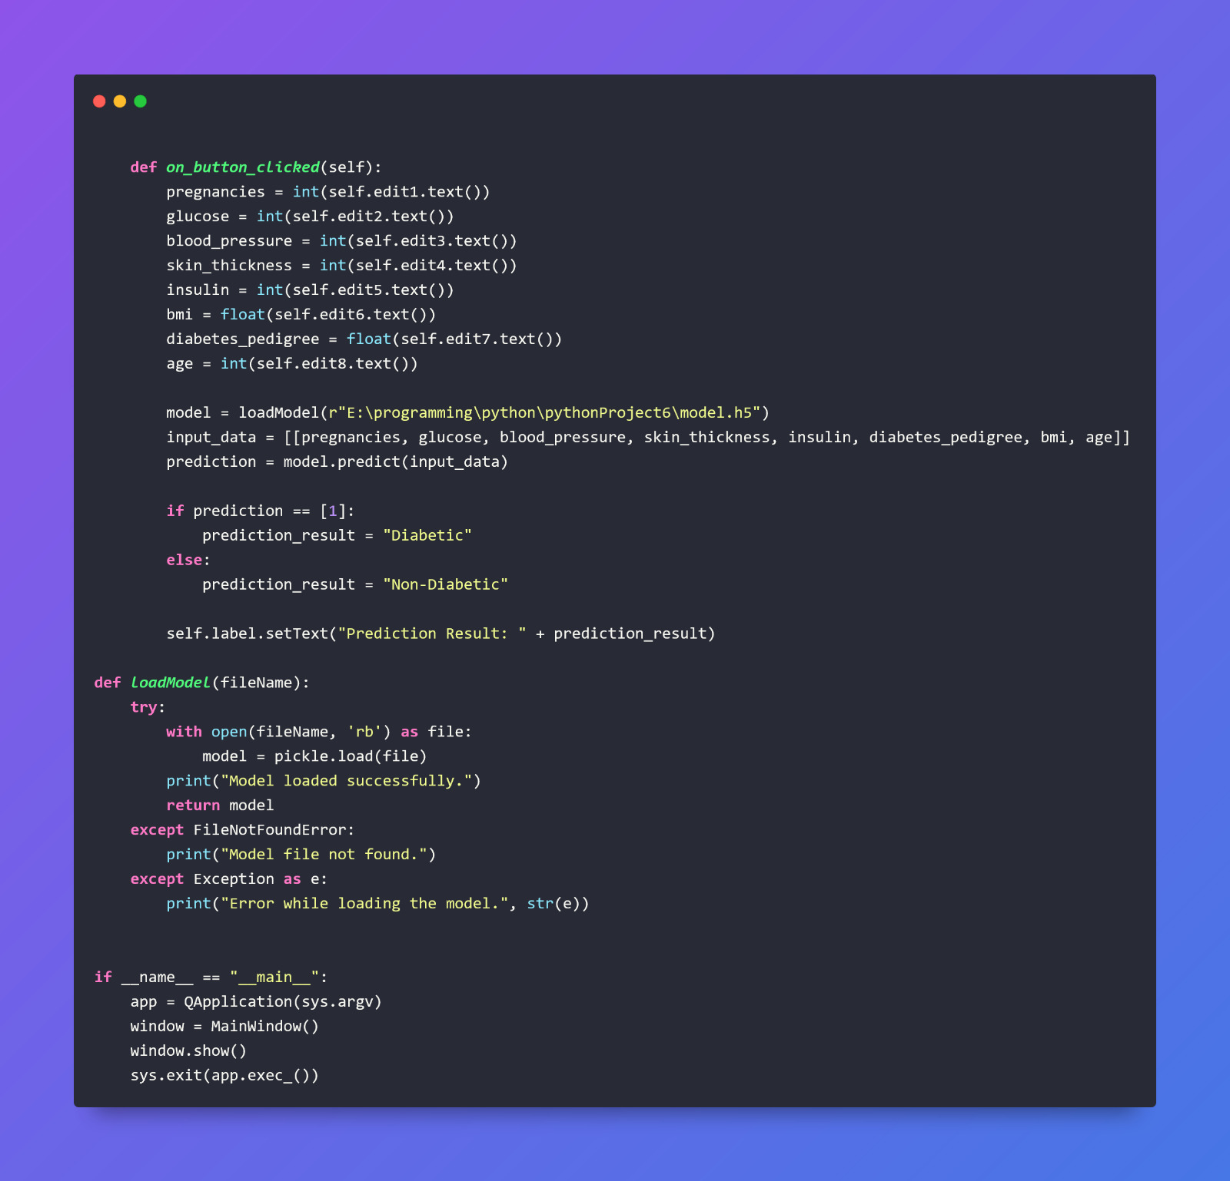
Build Desktop App

Slide 32
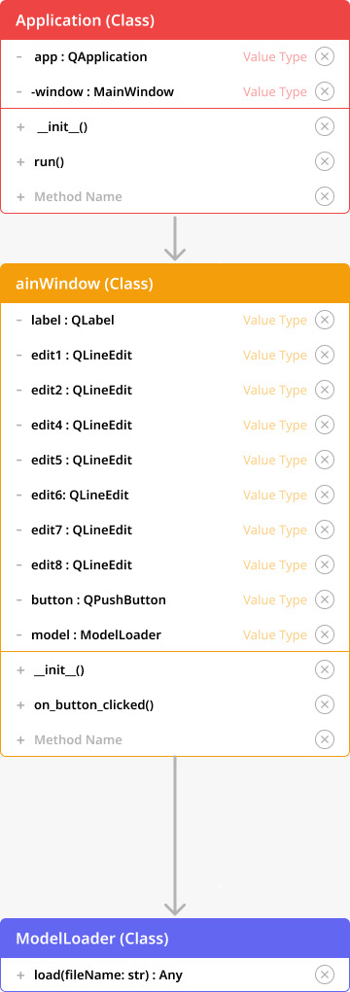
Uml Diagram Concept For The Gui App

Slide 33
Diabetes
Download Link:
T
26

Slide 34
Thanks!
T
27

